Slide 1
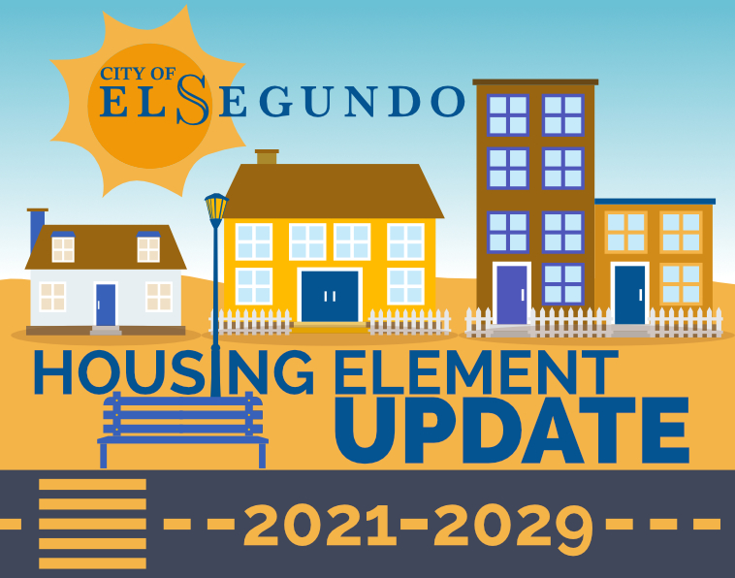
El Segundo
Housing Element Update
Planning Commission
September 30, 2021
5:30 PM
Notes:
Objective of this workshop

Slide 2
Housing Element Requirements
One of seven required General Plan Elements
Sets Citywide goals, objectives, policies, and identifies housing conditions and needs
An assessment and plan to accommodate City residents’ current & future housing needs
Plan for meeting City’s “fair share” of regional housing needs
Must be updated every 8 years October 15, 2021, statutory deadline (with 120-day grace period)
Will be reviewed by State Department of Housing and Community Development (HCD)

Slide 3
Housing Element Requirements
Legally required plan for where housing units may be built
Private sector builds the vast majority of housing units
City may use funds, policies, and programs as incentives to meet housing needs
City “sets the stage” for housing developers to build projects in line with the City’s General Plan, zoning ordinance, and other planning documents

Slide 4
Housing Element Requirements
Plan for projected housing demand, as required by State of California (RHNA)
Increase housing production where needed to meet demand
Preserve existing affordable housing units
Improve safety, quality, and condition of existing housing
Facilitate housing production for all incomes, household types, & special needs groups
Promote fair housing choice for all

Slide 5
Regional Housing Needs Allocation (RHNA) for 2021-2029
HCD
SCAG
State
Regional Planning Agencies
El Segundo
Manhattan Beach
Hawthorne
Inglewood
492
1,734
774
7,439
Estimated RHNA
LA County
LA County
812,060
Nearby Cities
Hermosa Beach
558
Redondo Beach
2,490
Each jurisdiction’s Housing Element must show how it can accommodate its RHNA number.
Notes:
The current RHNA for El Segundo in the current planning period from 2014-2021 is 69 housing units.

Slide 6
El Segundo’s RHNA Allocation
Income Category | 5th Cycle Carryover | 6th Cycle RHNA | Total RHNA | Percent
Extremely/Very Low Income | 18 | 189 | 207 | 39.7%
Low Income | 11 | 88 | 99 | 19.0%
Moderate Income | 0 | 84 | 84 | 16.1%
Above Moderate Income | 0 | 131 | 131 | 25.1%
Total | 29 | 492 | 521 | 100.0%
Notes:
Explain AMI verbally

Slide 7
El Segundo’s RHNA Strategy
 | Very Low | Low | Moderate | Above Moderate | Total
Overall RHNA (Including 5th Cycle Carryover) | 207 | 99 | 84 | 131 | 521
ADUs | 14 | 34 | 5 | 27 | 80
Entitled Projects | 0 | 0 | 0 | 4 | 4
Pending | 3 | 29 | 0 | 231 | 263
Candidate Rezone Sites | 214 | 89 | 100 | 11 | 414
Total | 231 | 152 | 105 | 273 | 761
Surplus/Shortfall | +24 | +53 | +21 | +142 | +240
 | 12% | 54% | 25% | 108% | 46%
Notes:
Explain AMI verbally

Slide 8
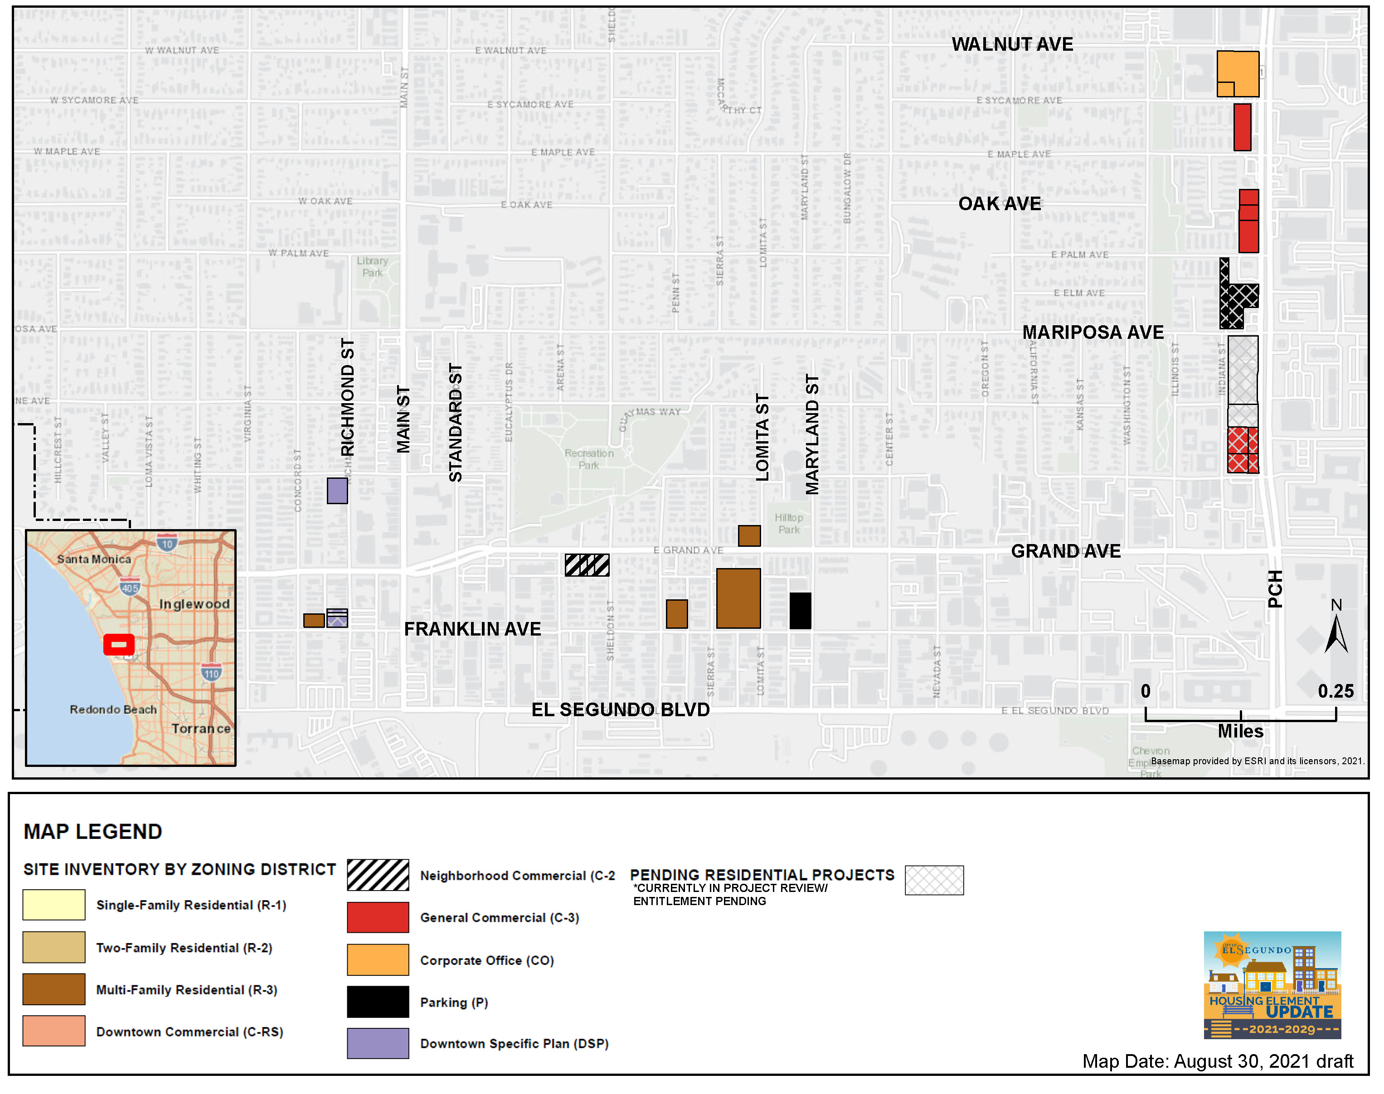
Notes:
Explain AMI verbally

Slide 9
Housing Programs
Program | Status
Housing Rehabilitation | Pursue funding to reinstate
Code Compliance | Existing
Accessory Dwelling Units | New, required by State law
Inclusionary Housing Ordinance/Affordable Housing Strategy | New
Provision of Adequate Sites | New, required by State law
Monitoring of No Net Loss | New, required by State law
Lot Consolidation | Existing
Municipal Code Amendments | New, required by State law
Fair Housing Program | New, required by State law
Notes:
Explain AMI verbally

Slide 10
Next Steps
June 2021: Initiate Mitigated Negative Declaration (MND)
September 2021: Finalize Sites Inventory and Draft Housing Element
October 2021: Submit Draft Housing Element to HCD for review
December 2021: Finalize Housing Element
January 13, 2022: Planning Commission Recommends Housing Element
February 1, 2022: City Council Adopts Housing Element and Submits to HCD for Final Certification
Notes:
Certification must occur within 120 days of statutory deadline.

Slide 11
Housing Element Update Video

